Slide 1
HEMATOLOGY CASE SCENARIOS

Slide 2
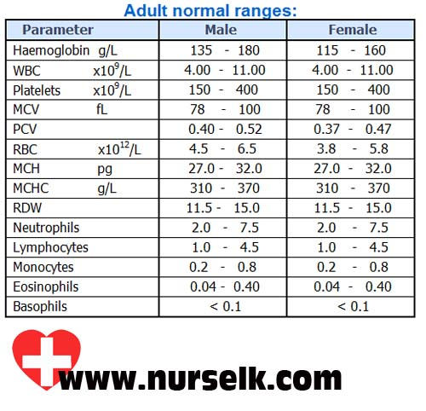

Slide 3
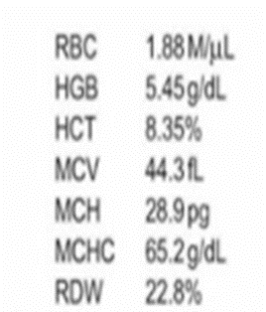
A 30 year old multiparous female complaining of unexplained fatigue, dizziness and shortness of breath on exertion. Laboratory data is given below.
Write the diagnosis, describe and draw the peripheral blood picture

Slide 4
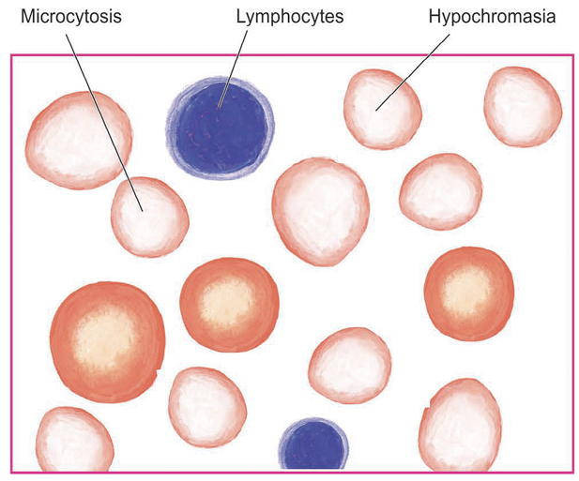
Diagnosis: Anaemia
PERIPHERAL SMEAR REPORT
RBC: Microcytic hypochromic
WBC: -----------
PLATELETS:--------
HEMOPARASITES: Not seen
OTHERS:----------
IMPRESSION: Microcytic hypochromic anaemia

Slide 5
Case Scenario
A 55yr old male comes to ER with acute chest pain and sweating. Probable clinical diagnosis is MI. What are the peripheral smear findings?
RBC: Normocytic normochromic
WBC: Increase in total count
Mild neutrophilia
(Neutrophilic leucocytosis)
Platelets: Adequate.
Hemoparasites: Not seen
Impression: Neutrophilic leucocytosis

Slide 6
2.A 10yr old male child admitted with acute abdomen. Probable clinical diagnosis is acute appendicitis. Write the peripheral smear findings.
RBC: Normocytic normochromic
WBC: Increase in total count
Neutrophils – increased
(Neutrophilic leucocytosis)
Platelets: Adequate
Hemoparasites: Not seen
Impression: Neutrophilic leucocytosis

Slide 7
3.A 1yr old male presented with 2weeks history of cough and shortness of breath. The probable clinical diagnosis is whooping cough. Write the peripheral smear findings.
RBC: Normocytic normochromic
WBC: Increase in total count (Leucocytosis)
Increased lymphocytes (Lymphocytosis)
Platelets: Adequate
Hemoparasites: Not seen
Impression: Leucocytosis with lymphocytosis

Slide 8
4.A 50yr old male presented with persistent productive cough for one month with history of loss of weight and loss of appetite. X-ray chest shows cavitary lesion in the apex of the right lung. Write the peripheral smear report.
RBC: Normocytic hypochromic
WBC: Increase in total count (Leucocytosis)
Lymphocytes – increased (Lymphocytosis)
Platelets: Adequate
Hemoparasites: Not seen
Impression: Lymphocytic leukocytosis

Slide 9
5.A chronic asthmatic presents to ER with exacerbation of asthmatic attack. Write the peripheral smear report.
RBC: Normocytic normochromic
WBC: Increase in total count (Leucocytosis)
Eosinophils – increased (Eosinophilia)
Platelets: Adequate
Hemoparasites: Not seen
Impression: Leucocytosis with Eosinophilia

Slide 10
6.37yr old pregnant laborer came to antenatal OP. CBP was sent as part of antenatal screening. Write the peripheral smear findings.
RBC: Microcytic hypochromic
WBC: Within normal limits
Platelets: Adequate
Hemoparasites: Not seen
Impression: Microcytic hypochromic anemia

Slide 11
7.60yr old diabetic lady admitted to surgical ward with cellulitis of leg. Write the peripheral smear findings.
RBC: Microcytic hypochromic
WBC: Total count - increased
Neutrophils – increased (Neutrophilic leucocytosis)
Platelets : Adequate
Hemoparasites: Not seen
Impression: Microcytic hypochromic Anemia with Neutrophilic leucocytosis

Slide 12
8.A 35yr old lady presents with petechial rash with bleeding gums. Probable clinical diagnosis is ITP. Write the peripheral smear findings.
RBC: Normocytic hypochromic
WBC: Counts within normal limits
Platelets: Markedly reduced (Severe Thrombocytopenia)
Hemoparasites: Not seen
Impression: Normocytic hypochromic blood picture with Thrombocytopenia

Slide 13
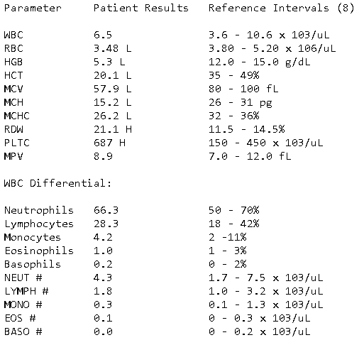
PA 14.3 Identify and describe the peripheral smear
A 22 year old college student was experiencing extreme fatigue with history of heavy menstrual bleeding. Laboratory parameters are given below. Examine the given peripheral smear and identify the condition

Slide 14
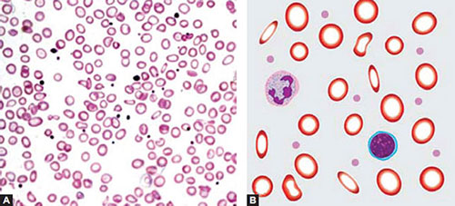
PERIPHERAL SMEAR REPORT
RBC: Microcytic hypochromic
WBC: Counts within normal limits
PLATELETS: Thrombocytosis (reactive)
HEMOPARASITES: Not seen
OTHERS:-----------
IMPRESSION: Microcytic hypochromic anaemia with reactive thrombocytosis

Slide 15
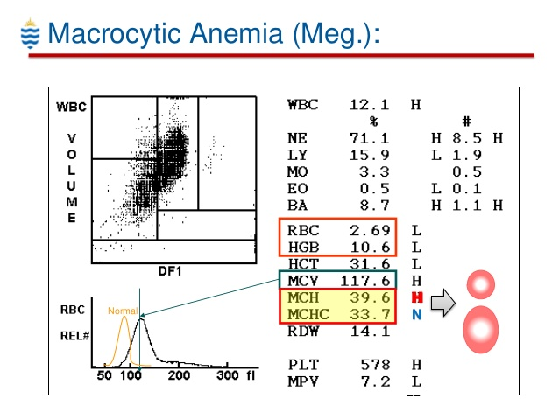
PA15.3 Identify and describe the peripheral blood picture of macrocytic anemia
33 year old vegetarian alcoholic male complaints of fatigue, loss of appetite, tingling numbness of feet and hands. Describe peripheral smear and identify the condition
72
23
3.0
2.0
00

Slide 16
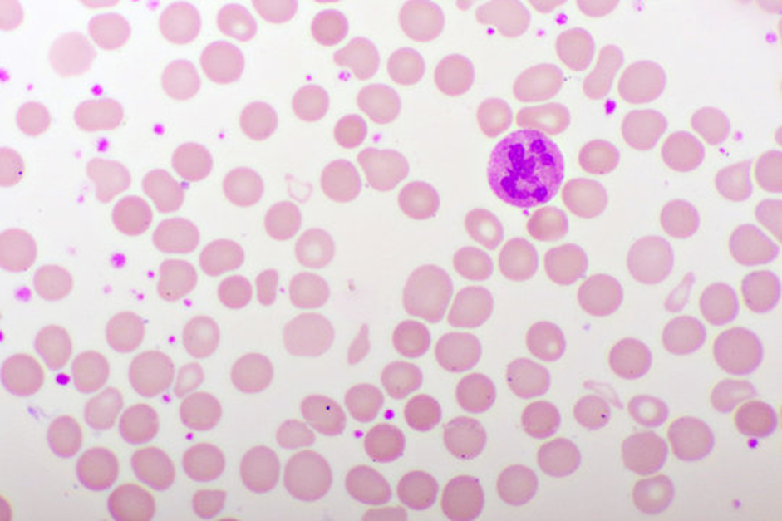
PERIPHERAL SMEAR REPORT
RBC: Macrocytic blood picture
WBC: Neutrophilic leucocytosis
PLATELETS: Thrombocytosis
HEMOPARASITES: Not seen
OTHERS:-----------
IMPRESSION: Macrocytic anaemia with neutrophilic leukocytosis and thrombocytosis
Hypersegmented neutrophil
Teardrop cell
Macroovalocyte

Slide 17
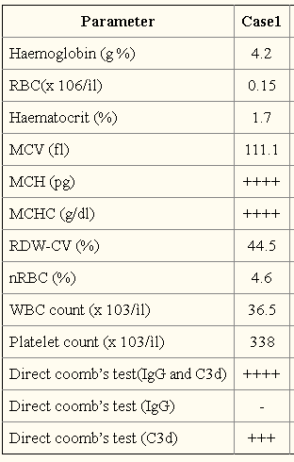
PA16.6 Prepare a peripheral blood smear and identify hemolytic anemia from it
16 month old female child presented with pallor for 1 month, difficulty in breathing and fever for 5 days. History of previous blood transfusion present. O/E, liver 3cm BCM, spleen 3cm BCM
61.1
19.4
31.9

Slide 18
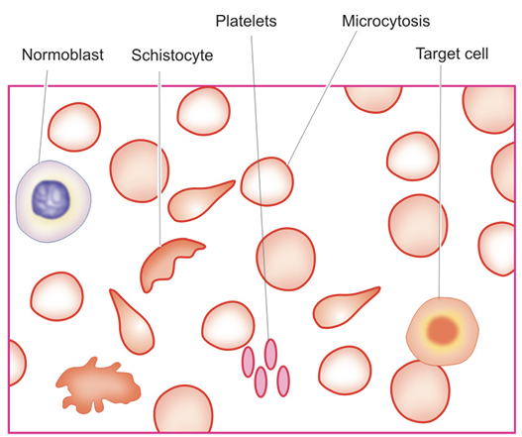
PERIPHERAL SMEAR REPORT
RBC: Anisopoikilocytosis. Microcytic hypochromic cells, normocytes, target cells, tear drop cells, schistocytes present. nRBCs seen.
WBC: Leucocytosis
PLATELETS: Adequate
HEMOPARASITES: Not seen
OTHERS:-----------
IMPRESSION: Hemolytic anaemia
with leucocytosis

Slide 19
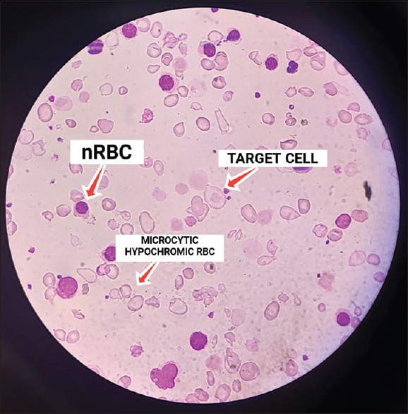

Slide 20


